Slide 1
Presentation on c# programms
By
NARALA praveen

Slide 2
Agenda:
Bubble sort using array functions .
Linear search using array functions.
Binary search using array functions.

Slide 3
What is Bubble sort?
Bubble sort is a sorting algorithm that works by repeatedly stepping through lists that need to be sorted, comparing each pair of adjacent items and swapping them if they are in the wrong order. This passing procedure is repeated until no swaps are required, indicating that the list is sorted .

Slide 4
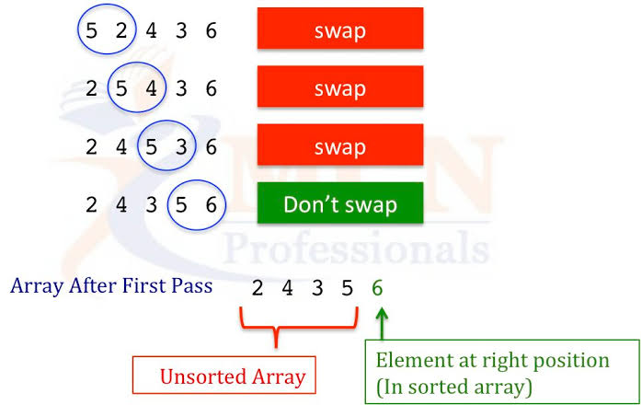

Slide 5
using System;
Using System.Collections.Generic;
Using System.Linq;
Using System.Text;
Using System.Threading.Tasks;
Namespace Bubblesort
{
//*******************************************************************\\
//Author:Narala Praveen //Purpose:using Arrays bubble sort program
//**********************************************************************\\
internal class Program
{
static void Main(string[] args)
{
//Array Initialization
int[] data = new int[] { 44, 82, 56, 78, 49, 48 };
int praveen;

Slide 6
//logic
for(int I = 0; I < data.Length-2;i++)
{
for(int j=0;j<=data.Length-2;j++)
{
if (data[j] > data[j + 1])
{
praveen = data[j + 1];
data[j+1]=data[j];
data[j] = praveen;
}
}
}
//Ouput
foreach(var d in data)
Console.WriteLine(d);
Console.ReadLine();
}
}
}

Slide 7
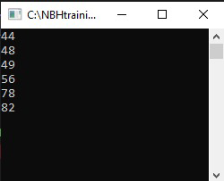
Output :

Slide 8
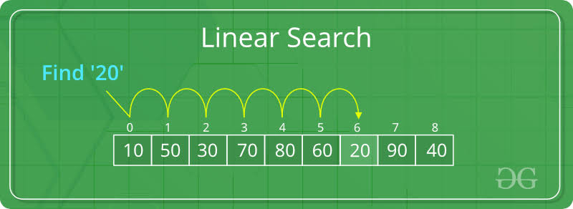
What is Linear search ?
A linear search (or) sequential search is a method for finding an element within a list . It sequentially checks each element of the list until a match is found or the whole list has been searched .

Slide 9
using System;
Using System.Collections.Generic;
Using System.Linq;
Using System.Text;
Using System.Threading.Tasks;
Namespace LInearsearch2
//***************************************************\\
//Author:Narala Praveen
//Purpose:Linear Search using Arrays
//****************************************************\\
{
internal class Program
{
static void Main(string[] args)
{
//Array Declaration and Initialization
int[] data = new int[] { 101,201,85,65,95,86,98,38 };
//Reading user input

Slide 10
Console.WriteLine(“Enter input value:”);
int input = Convert.ToInt32(Console.ReadLine());
//using for loop
//Logic and Output
for (int I = 0; I < data.Length; i++)
{
if (data[i] == input)
{
Console.WriteLine($"The number {input},is in index{i},at position {i + 1}");
Console.ReadLine();
}
}
//if number not found
Console.WriteLine("number not found");
Console.ReadLine();
}
}
}

Slide 11
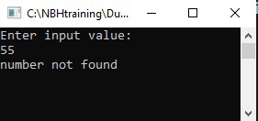
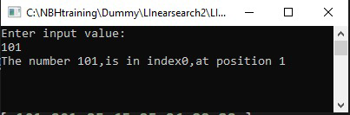
Output :

Slide 12
What is Binary search ?
In computer science, binary search, also known as half-interval search, logarithmic search, or binary chop, is a search algorithm that finds the position of a target value within a sorted array If the search ends with the remaining half being empty, the target is not in the array.

Slide 13
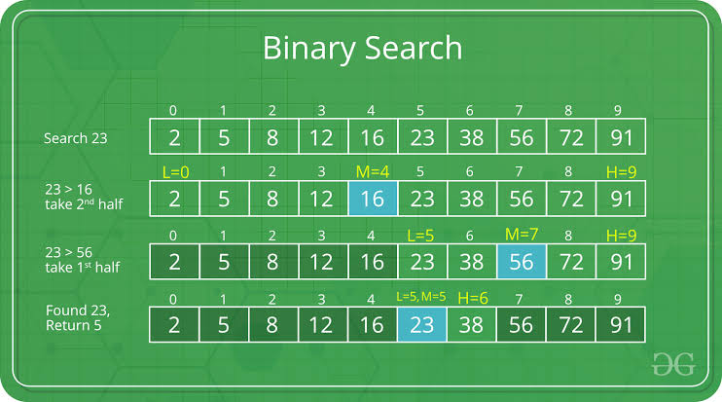

Slide 14
using System;
using System.Collections.Generic;
Using System.Linq;
Using System.Text;
Using System.Threading.Tasks;
Namespace
BinarySearch
{
//Author: Narala praveen
//Purpose: Binary search
internal class Program
{
//Binary search function
public static int Binarysearch(int[] data, int i)
{
int left = 0;
//initially
int right = data.Length – 1;
//At end

Slide 15
while (left <= right)
{
int mid = (left + right) / 2;
if (I < data[mid])
{
right = mid – 1;
}
else if (I > data[mid])
{
left = mid + 1;
}
else
{
return mid;
}
}
return 0;
//if condition fails

Slide 16
}
static void Main(string[] args)
{
// Array declaration and Initialisation
int[] data = new int[] { 44,65,84,99,12,47,65,58 };
//search an element in the array
Console.WriteLine("Enter number to search");
int i = Convert.ToInt32(Console.ReadLine());
int result = Binarysearch(data, i);
if (result <= 0)
{
Console.WriteLine($”The number you searched {i} not found”);
}
else
{
Console.WriteLine($"The number you searched {i} Found at index {result}");
}
Console.ReadLine();
}
}
}

Slide 17
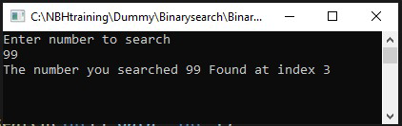
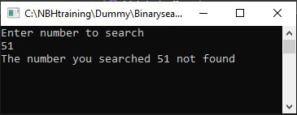
Output:

Slide 18

Thank you

